Slide 1

Encryption Algorithm Comparison CSCI-2246-01 Introduction to Computer Security Spring 2021
Justin Hollman, Orion Duffy, Ahmed Muntasir Hossain
Notes:
Justin

Slide 2
Introduction
Encryption Algorithms are used to change data in a predictable way using a key so that it cannot be read without decrypting it with the correct key
Symmetric Key Encryption: same key is used for encryption and decryption
Asymmetric Key Encryption: different keys are used for encryption and decryption
Developed an application in C++ to test the speed of
Symmetric key encryption algorithms: AES and 3DES
Asymmetric key encryption algorithm: RSA
Compared the costs and benefits of each type of encryption algorithms
Notes:
Justin

Slide 3
Analysis - Algorithm
Imported an open-source library used by professional developers called Crypto++
Compiled the cryptopp.lib file to include the headers for AES, 3DES, and RSA encryption algorithms
Developed the code in C++ which included:
Plaintext
Encryptor
Print ciphertext
Decryptor
Print decryptedtext
Notes:
Justin

Slide 4
Analysis - Time
Used chrono library to measure the time for encryption and decryption
Ran several encryption and decryption processes for each algorithm
Printed the time taken for encryption and decryption on each run
Computed the total time and calculated the average of all the runs for each algorithm
Expected RSA to take a significantly longer time to run than AES and 3DES
Results support our hypothesis
Notes:
Muntasir

Slide 5
Symmetric Key - Duration
AES | Encryption Time (μs) | Decryption Time (μs) | Total Time (μs)
Run 1 | 449 | 203 | 652
Run 2 | 61 | 73 | 134
Run 3 | 68 | 75 | 135
Average Time | 193 | 117 | 307
3DES | Encryption Time (μs) | Decryption Time (μs) | Total Time (μs)
Run 1 | 447 | 425 | 872
Run 2 | 485 | 652 | 1117
Run 3 | 213 | 230 | 443
Average Time | 382 | 436 | 810
Notes:
Muntasir

Slide 6
Asymmetric Key - Duration
RSA | Encryption Time (μs) | Decryption Time (μs) | Total Time (μs)
Run 1 | 1133 | 23923 | 25056
Run 2 | 977 | 28034 | 29011
Run 3 | 2854 | 34538 | 37392
Run 4 | 923 | 28091 | 29014
Average Time | 1472 | 21624 | 30118
Notes:
Muntasir

Slide 7
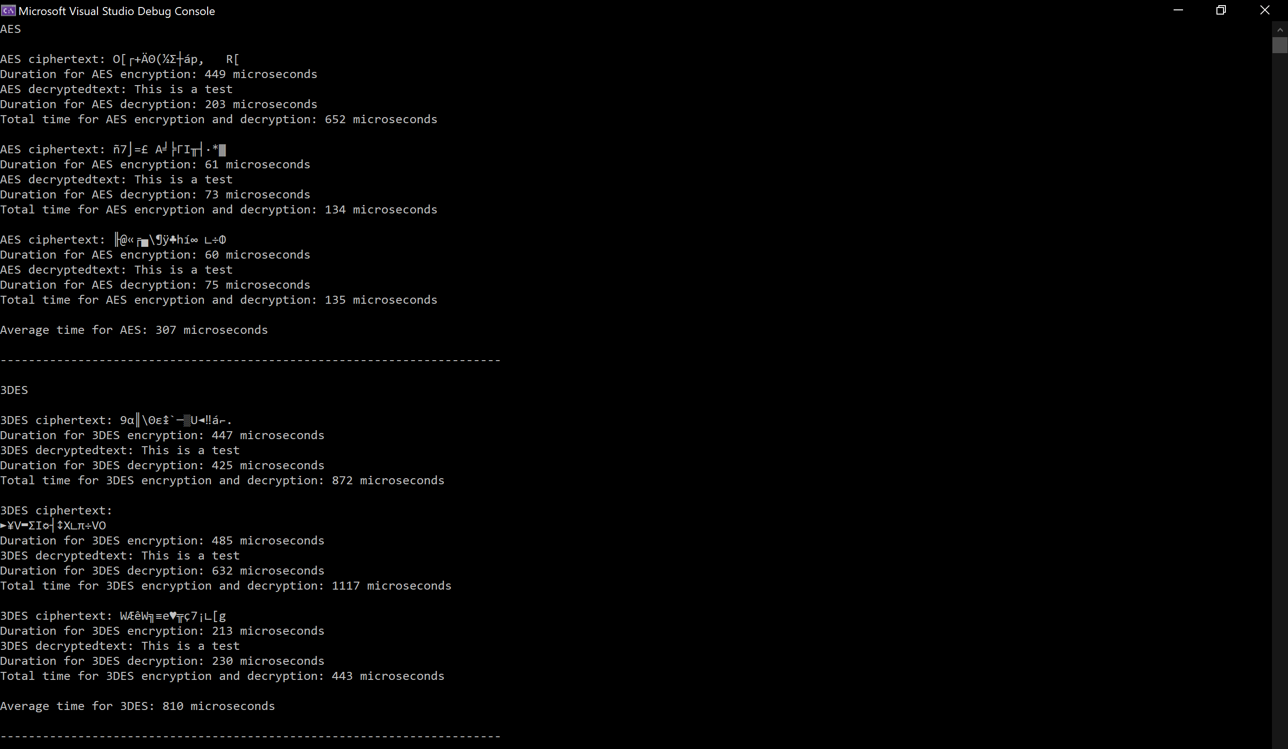
Symmetric Key Results C++
Notes:
Muntasir

Slide 8
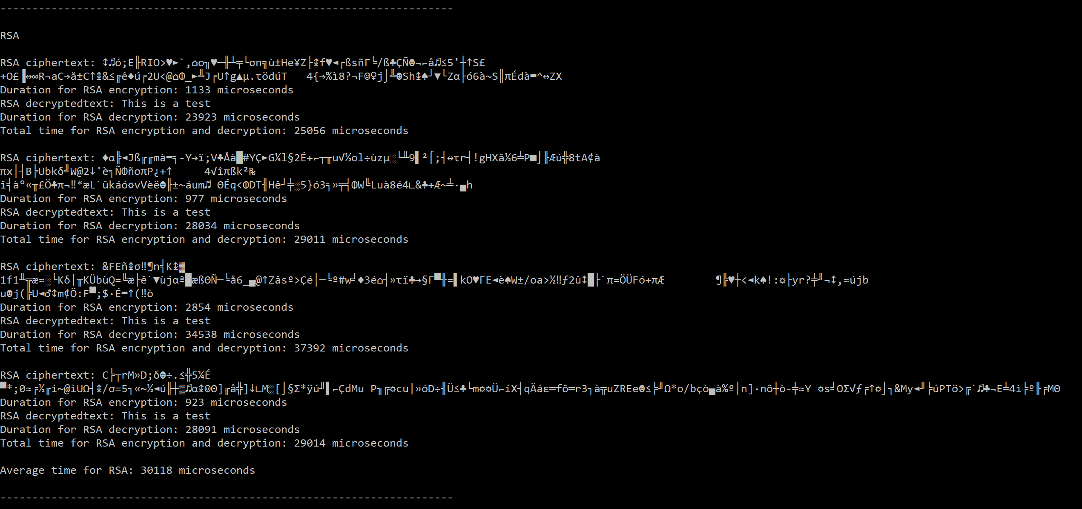
Asymmetric Key Results C++
Notes:
Muntasir

Slide 9
Impact on Computer Security
Symmetric key encryption is faster
The key must be transferred to the other party
Asymmetric key encryption is far, far, slower
Sharing the key that allows decryption is not necessary
Symmetric key encryption is used for large quantities of data
Asymmetric key is more reasonable for small quantities
Asymmetric key encryption is often used to transfer the key for symmetric key encryption
Notes:
Orion

Slide 10
Conclusions
Encryption and decryption done using Crypto++ library
Tested AES, 3DES and RSA algorithms
Compared their performance and times
Symmetric key algorithm is faster
Asymmetric key algorithm is slower but does not require the user to share the key
Notes:
Orion

Slide 11
GitHub
https://github.com/muntasir-hossain314159/Encryption-Algorithm-Comparison
Notes:
Orion

Slide 12
Thank You

